Slide 1
Innovation Strategy as the Management of Competencies
Master: Dr.Goodarzi
BY: Somaie Meisami

Slide 2
A comprehensive model of innovation strategy
based this element of corporate strategy on two main pillars. The first pillar was the definition of a desired portfolio of competencies and the planning of their development. The other pillar was the outlining of a portfolio of product and market development activities

Slide 3
Mapping and Planning a Competency Portfolio
In order to manage and develop the competencies portfolio of a firm, the first issue to be solved has to do with
classifying
and assessing competencies
There is no fixed rule in performing this exercise, and each firm will be likely to develop its own method.

Slide 4
classify and measure routines
The firm can therefore define a directory of relevant competencies and then make an inventory of the resources pool that are associated to each.
A firm may therefore consider its human resources and use the headcount of employees who share a same competence.
In the case of competencies requiring capital-intensive assets, the company could also use fixed assets (e.g., the book value of laboratory equipment associated to each competency).
Alternatively, in the case of industries where intellectual property is highly relevant, the firm could list competencies by using patent classifications and then measure them by counting its patents.

Slide 5
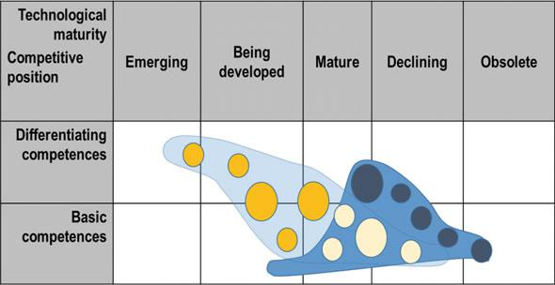
bubble charts for representation of competencies
Management will identify two axes for locating each competence, and the size of the related resources pool will be represented by the diameter of the bubble
Fig. 8.1 An example bubble chart representing an “As-Is” portfolio of corporate competencies (area to the right) and a “To-Be” one (area stretching top left to bottom right)

Slide 6
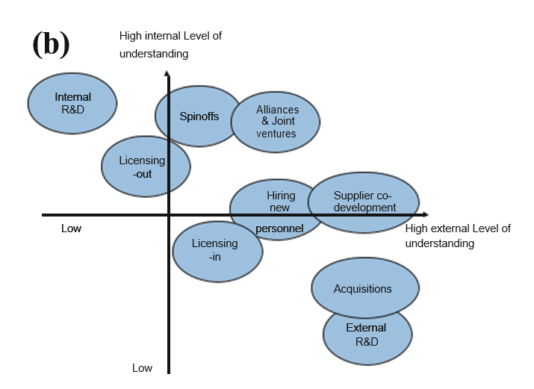
The main trade-offs in choosing an approach for competency development

Slide 7
Identify HOW competencies have to be developed
internally by the firm (“make”)
by using selected suppliers (“buy”)
or by associating with complementors and customers

Slide 8
WHAT KIND OF COMPETENCE?
competence is recognized to be :
core (in-house development will obviously be recommended in this case)
non-core and generic (contracting with generic suppliers will in general make sense, unless cost analysis suggests differently)

Slide 9
The Relationship Between R&D Expenditure and Corporate Performance
ratio between R&D expenditure and sales
the ratio between R&D expenditure and GDP

Slide 10
organizational intelligence
The capability of changing and adapting its resources and routines
A firm with high organizational intelligence will be able to capture opportunities coming from the knowledge generated by R&D activity, and it will be therefore appropriate for such a firm to make this kind of investment. Conversely, a firm with low organizational intelligence will not be able to extract value out of R&D and should therefore avoid committing too many resources into it.

Slide 11
worker productivity and incentives
The difference between a brilliant and highly motivated employee and a mediocre and dispirited one can be very high, and the firm should consider whether its R&D personnel are delivering as much value as their salaries are worth

Slide 12
Fig. 8.3 Centralized and decentralized R&D in large firms

Slide 13
Corporate Venturing
In corporate venturing, the focal firm acts as a venture capital fund and takes equity stakes in young technology-based companies, either directly, or by setting up an independent corporate venture capital arm.

Slide 14
Fig. 8.4 Trade-offs in external versus internal development of projects
The firm will decide not to back development if V + EV − D < 0 while the researcher will not start a venture if V < 0. As shown in Fig. 8.4, the combination of these two decision rules leads to three possible outcomes.
If V > 0 and EV > D, the project will be backed by the firm while, if EV < D, it will be developed externally.
If V < 0 and V + EV − D > 0 it will be backed by the firm while, if V + EV − D < 0, it will be abandoned by both parties.

Slide 15
Technology Acquisitions
Acquisitions are a common event in corporate history and can occur for many different reasons, such as gaining access to a market or a customer portfolio, securing physical assets (e.g., plants and machinery), or obtaining desired competencies. The latter case is often referred to as a technology acquisition.

Slide 16
Corporate Venturing
Hiring Human Resources
Non-equity Strategic Alliances
Equity-Based Alliances and Joint Ventures
Co-development
Open Innovation
Complete Outsourcing
Technology Acquisitions

Slide 17
Corporate Venturing
In corporate venturing, the focal firm acts as a venture capital fund and takes equity stakes in young technology-based companies, either directly, or by setting up an independent corporate venture capital arm.

Slide 18
Ecosystem Venturing
the focal firm may use a corporate venturing unit to manage the stakes it owns in its own corporate spin-offs. Finally, the focal firm may take stakes in firms that are developing technology or products that are complementary to the firm’s core competency. This latter strategy is termed ecosystem venturing, and follows the rationale that, by supporting the growth of these companies, demand for the focal firm’s products will increase.

Slide 19
Hiring Human Resources
A firm that lacks competencies in a given area may resort to hiring employees that already possess the underlying knowledge, either as fresh graduates from a relevant academic curriculum, or as professionals who already have some work experience in the field.
The hiring of multiple individuals has significant transaction costs, which can ultimately be comparable to those required to acquire a company of the same size.
the productivity of new hires is usually low, until their integration is completed.

Slide 20
Non-equity Strategic Alliances
A second family of methods for gaining access to competencies is involved with creating links with external entities, thus accepting to give up part of the appropriability of the related economic value. The basic way to do so is to create a strategic alliance with another firm, and pursue a joint program of activities, which may include R&D and product development

Slide 21
Equity-Based Alliances and Joint Ventures
Equity-based alliances and joint ventures have similar objectives to non-equity alliances, but are based on a deeper institutional linkage between participating entities. These entities may exchange shareholdings directly or—more commonly—in an alliance-specific joint venture. At least in principle, the institutional nature of the linkage creates less ambiguity than a purely contractual one.

Slide 22
Co-development
Co-development often occurs when a company needs to develop components that require highly specific competencies but does not wish—or is unable—to build these competencies in-house, and therefore has to ask a supplier.
In this context, specificity means that these competencies and the ensuing products will be of little or no value, if offered to competitors of the customer company.

Slide 23
Fig. 8.5 Choosing among the different types of co-development

Slide 24
Open Innovation
Open Innovation can be viewed as an “umbrella” term that encompasses a number of approaches for accessing and developing competencies by looking outside the boundaries of the firm and its immediate surroundings.

Slide 25
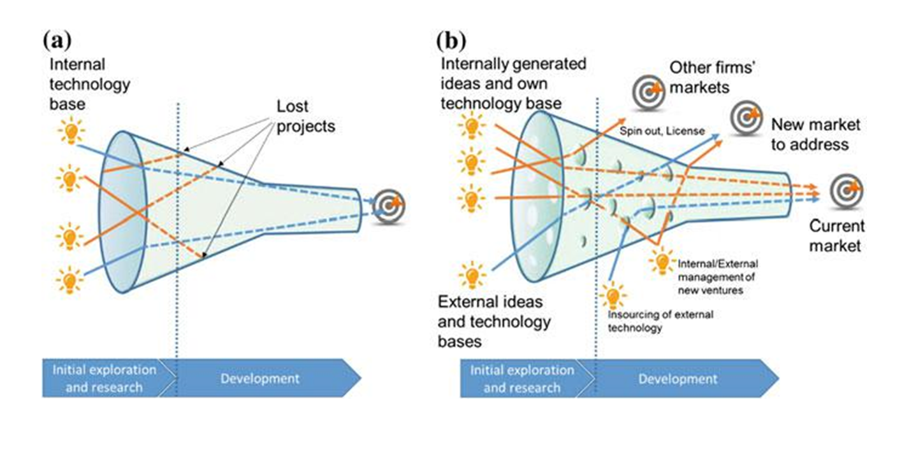
Fig. 8.6 The traditional (closed funnel) approach to innovation, compared to the Open Innovation (open funnel) approach

Slide 26
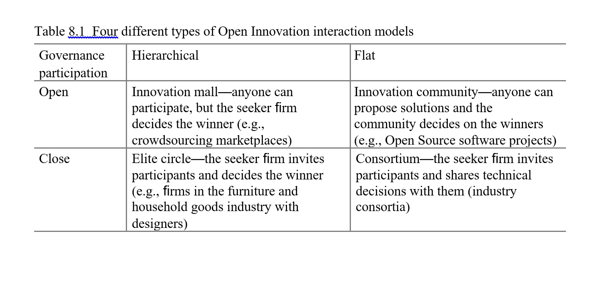

Slide 27
Complete Outsourcing
In this context, complete outsourcing means that the firm recognizes that a given technological area is non-core, and therefore gives up any further attempt to develop it either internally or through partnerships. From this moment on, the outcomes of this technology will be seen as “black box” components to the firm’s products, and the firm will limit itself to specifying its needs, negotiating purchasing agreements, and checking compliance with specifications.

Slide 28
THANK YOU

