Slide 1
Gaining competitive advantage through information systems
Presented by Saba nasiri

Slide 2
The PURPOSE OF THIS CHAPTER:
This chapter examines how organizations can use information systems (IS) strategically, enabling them to gain or sustain competitive advantage over their rivals.
we begin by examining the role of information systems at different levels of the organization. We then examine how information systems support various business models and introduce innovative business models enabled by information systems. Finally, we talk about the continual need to find innovative ways to succeed with and through information systems.

Slide 3
Startups and New Business Models:
enabling new products and services, rapid advances in the capabilities of information technology enable entirely new business models. Some are refinements to existing approaches, others can be highly disruptive.
Examples of technology-enabled business models include operating a platform, cutting out the middleman, selling subscriptions, and providing on-demand services.

Slide 4
Enabling Organizational Strategy through Information Systems

Slide 5
Business Processes
Business processes are the activities organizations perform in order to reach their business goals, including core activities that transform inputs and produce outputs, and supporting activities that enable the core activities to take place.

Slide 6
Organizational Decision-Making Levels:

Slide 7
Organizational Decision-Making Levels
1. operational level:
At the operational level of a firm, the routine, day-to-day business processes and interactions with customers occur. Information systems at this level are designed to automate repetitive activities, such as processing sales transactions, and to improve the efficiency of business processes at the customer interface.

Slide 8
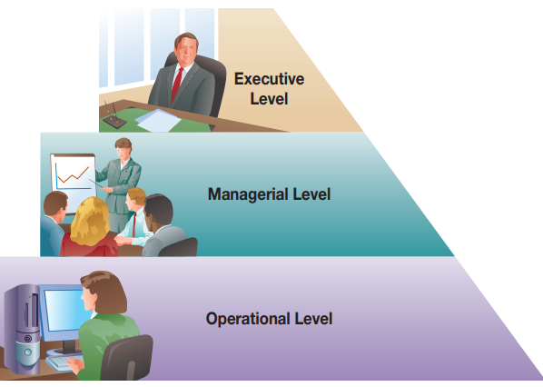
Structured decision:
Structured decisions are those in which the procedures to follow for a given situation can be specified in advance. Because structured decisions are relatively straightforward, they can be programmed directly into operational information systems so that they can be made with little or no human intervention.

Slide 9
Organizational Decision-Making Levels
2. Managerial\ Tactical level:
At the managerial level (or tactical level) of the organization, functional managers (e.g., marketing managers, finance managers, manufacturing managers, human resource managers) focus on monitoring and controlling operational-level activities and providing information to higher levels of the organization.

Slide 10
Organizational Decision-Making Levels
3. Executive\ strategic level:
managers focus on long-term strategic questions facing the organization, such as which products to produce, which countries to compete in, and what organizational strategy to follow,… .

Slide 11
Organizational Functional Areas:
In addition to different decision-making levels within an organization, there are also different functional areas
A functional area represents a discrete area of an organization that focuses on a specific set of activities.

Slide 12
Organizational Functional Areas:

Slide 14
The usage of information system and function:
When deploying information systems across organizational levels and functions, there are three general ways the information system can provide value: to enable automating activities, to enable learning, and to enable the execution of organizational strategy.

Slide 15
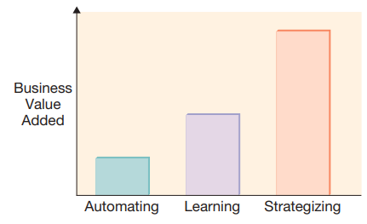
Information Systems for Automating: Doing Things Faster
Someone with an automating perspective thinks of technology as a way to help complete a task within an organization faster, more cheaply, and perhaps with greater accuracy and/or consistency.

Slide 16
Information Systems for Organizational Learning: Doing Things Better
We can also use information systems to learn and improve. By analyzing data created when automating a process, improved understanding about the underlying work processes can be developed. The learning mentality builds on the automating mentality because it recognizes that information systems can be used as a vehicle for organizational learning.

Slide 17
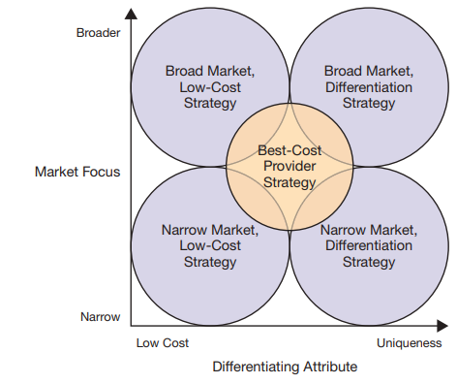
Information Systems for Supporting Strategy: Doing Things Smarter
the best way to use an information system is to support the organization’s strategy.

Slide 18
Identifying How to Compete: Resources and Capabilities

Slide 19
The Role of Information Systems in Value Chain Analysis
Because information systems can automate and optimize many activities along the value chain, the use of information systems has become one of the primary ways that organizations improve their value chains.

Slide 20
The Role of Information Systems in Value Chain Analysis

Slide 21
Valuing innovation
Innovation is key for organizations attempting to gain or sustain a competitive advantage, be it through cost or differentiation. For organizations, innovation involves creating new products, processes, or services that return value to the organization.

Slide 22
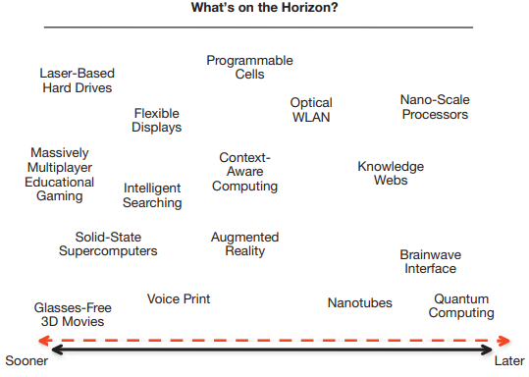
Kinds of innovation
1. Incremental innovation
2. radical\ disruptive innovation

Slide 23
Thanks for your attention

